Slide 1



Predictive Modeling for Heart Disease Assessment
Undergraduate Final Year Project
Bachelor of Data Science
Presented by: | Aya El Hajj

Slide 2
Outline
Introduction
Problem Statement
Project Design
Tools used in the project
Methodology
Results

Slide 3
Introduction
The problem of Heart Disease
Project Scope and Statement
Project Objectives
CRISP-DM Method

Slide 4
Problem Statement
Using machine learning algorithm
Develop a predictive modeling system
Choose the right machine learning algorithm
Integrate the model into a web app
Deploy the app for patients and doctors

Slide 5
Project Design
Choose the right database
Clean the database
Test the machine learning models
Choose the best model based on metrics
Deploy the best model to develop the web application
Develop a simple web application

Slide 6

Tools used in the project
Python:
Pandas for data cleaning
Numpy for data cleaning
Matplotlib for visualization
Seaborn for visualization
Sklearn for machine learning
Streamlit for app development
Microsoft office word for the report
Microsoft office power point for the presentation

Slide 7
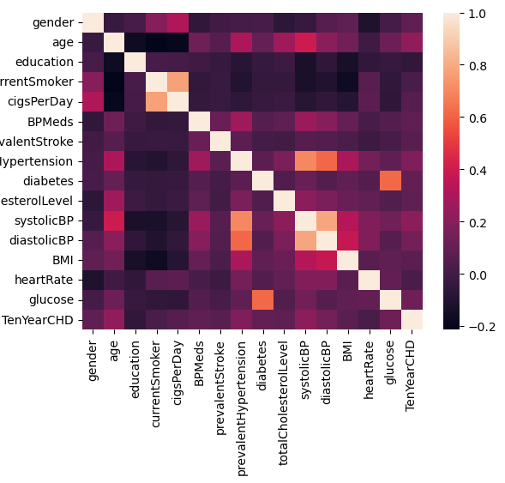
Methodology:
Correlation matrix:
No correlation between target variable and education → remove education feature

Slide 8
Methodology
Exploratory Data Analysis (EDA)
Dataset shape
Boxplots and histograms for numerical features
Bar plots for categorical features

Slide 9

Methodology
Data Cleaning:
Dealing with missing data
Remove
Remove NAs
Fill by
Fill by Mean and Mode
Fill by
Fill by KNN
Fill by
Fill by Next
Fill by
Fill by Previous

Slide 10
Methodology
Data Cleaning:
Dealing with outliers
Keep the outliers
1
Remove by Standard Deviation
2
Remove by IQR all
3
Remove using DBscan
4

Slide 11

Methodology
Data Cleaning:
Dealing with outliers
Tested each function
Remove by IQRAll → loss of all target variable 1 value
We will not be using the function

Slide 12
Methodology
Data Cleaning:
Features Selection
Select K best features
Select percentile of the features
Select based on variance threshold
Dimensionality reduction
Keep all the features

Slide 13

Methodology
Data Cleaning:
Balancing
Over Sampling
Under Sampling

Slide 14
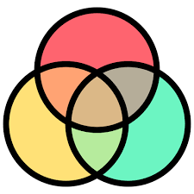
Methodology
Generate all possible data frames for modeling

Slide 15
Methodology
Modeling:
The below model will be tested on all the generated data frames
KNN (K nearest neighbor)
Logistic Regression
Decision Tree
Naïve Bayes
Random Forest
SVM (Support Vector Machine)

Slide 16
Methodology
Modeling:
Choosing the best model
Choose the top 5 data frames for each model
The choice is based on the metrics
Put all data frames in one list
Sort the list according to the metrics
Choose the top 3 data frames
Check which model is the best

Slide 17
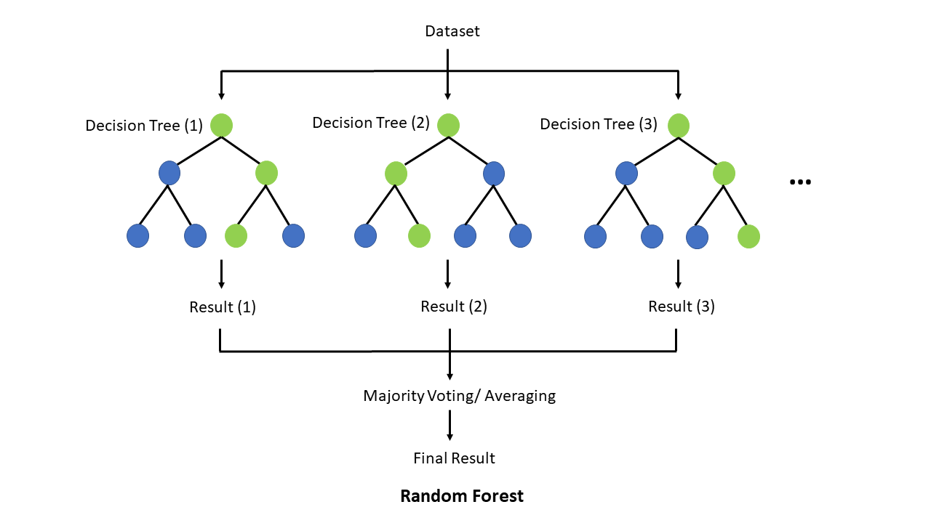
Methodology
Modeling:
Choosing the best model and data frame
Random Forest is the best model
Fill missing data by mean and mode
Remove outliers by Standard Deviation
Keep all the features
Over sampling

Slide 18
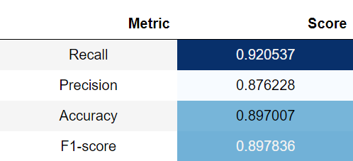
Random Forest Model Metrics

Slide 19
Methodology
Deployment
Simple web app
Using streamlit
Takes medical records from user
Generate percentage
Percentage is based on number of output 1 in the random forest model
Try it out !

Slide 20
Results
Predictive modeling system
Can be used by patients or doctors
Uses Random Forest algorithm
Help doctors prioritize patient treatment

Slide 21
Thank you for your attention !

